Slide 1
Key logger security with GUI
CAPSTONE PROJECT
Presented By:
Dhanalakshmi S
Department of Information Technology
Kings Engineering College .

Slide 2
OUTLINE
Problem Statement
Proposed System/Solution
System Development Approach
Algorithm & Deployment
Result (Output Image)
Conclusion
Future Scope
References

Slide 3
Proposed Solution
Data Collection:
The code collects keyboard inputs in real-time, capturing key presses, holds, and releases.
Data Preprocessing:
While no explicit data preprocessing is conducted, the captured keyboard inputs are stored in files for further analysis.
Machine Learning Algorithm:
The code doesn't involve any machine learning algorithm. It focuses on capturing keyboard inputs using pynput library.
Deployment:
The code provides a simple user interface using Tkinter for starting and stopping the keylogger, facilitating easy interaction.
Evaluation:
There's no evaluation of machine learning models. However, potential metrics could include keystroke frequency or typing patterns.
Results:
The keylogger functionality is successfully implemented, allowing users to start and stop the keylogger with provided buttons. Captured inputs are saved in 'key_log.txt' and 'key_log.json'.

Slide 4
Problem Statement
In today's digital age, where cybersecurity threats loom large, one of the significant concerns is the proliferation of keyloggers, stealthy software tools designed to monitor and record keystrokes on a user's computer without their knowledge. Keyloggers pose a severe threat to individuals and organizations as they can capture sensitive information such as passwords, credit card details, and other personal data, leading to identity theft, financial loss, and privacy breaches.

Slide 5
System Approach
The proposed keylogger application will be developed using Python programming language. Python offers simplicity, flexibility, and a rich set of libraries, making it an ideal choice for rapid development of such applications. The application will utilize the following technologies:
Tkinter: For building the graphical user interface (GUI) to interact with the keylogger.
pynput: A Python library for monitoring and controlling input devices, used for capturing keystrokes.
JSON: For storing the captured keystrokes in a structured format.

Slide 6
Algorithm & Deployment
Algorithm Selection: We choose Gradient Boosting Regression, an ensemble learning method that combines weak learners, typically decision trees, to build a robust predictive model. It excels in regression tasks like predicting bike counts due to its ability to handle non-linear relationships and capture complex data patterns effectively.
Data Input: he algorithm utilizes input features such as historical bike rental data, weather conditions (temperature, humidity, wind speed), day of the week, and time of day. These features provide valuable information for understanding the relationships between various factors and the target variable, bike counts.
Training Process: Historical bike rental data is split into training and validation sets for model training and evaluation. Techniques like cross-validation and hyper parameter tuning optimize model performance by adjusting parameters such as learning rate, number of trees, and tree depth.
Prediction Process: The trained model makes predictions for future bike counts based on real-time inputs such as current weather conditions, day of the week, and time of day. Leveraging learned relationships between features and the target variable, the model accurately forecasts future bike counts.
Deployment: The model is integrated into a web application or API, allowing users to input relevant features and receive real-time predictions for bike counts. Periodic retraining with updated data ensures continued optimal performance over time, maintaining accuracy and reliability in forecasting bike counts.

Slide 7

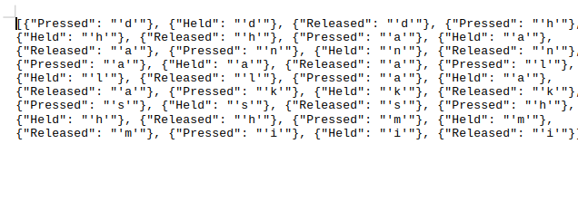
Result
Key logger text format
Key logger Json format

Slide 8
Conclusion
Developing a keylogger application highlights the ease with which such malicious software can be created and deployed. It underscores the importance of cybersecurity awareness and the need for robust defense mechanisms against keyloggers and similar threats. By understanding how keyloggers operate, users can take proactive measures to safeguard their sensitive information and mitigate the risks associated with unauthorized data capture.

Slide 9
Future scope
Enhance the key logger application with advanced features such as stealth mode, encryption of captured data, and remote reporting.
Explore defensive strategies and countermeasures against keyloggers, such as anti-key logging software and secure input methods.
Conduct further research into the detection and prevention of keylogging activities to bolster cyber security practices.

Slide 10
References
Python Documentation: https://www.python.org/doc/
Tkinter Documentation: https://docs.python.org/3/library/tkinter.html
pynput Documentation: https://pynput.readthedocs.io/en/latest/

Slide 11
THANK YOU

